Slide 1
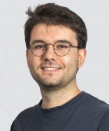
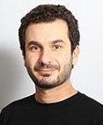
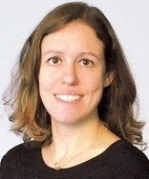
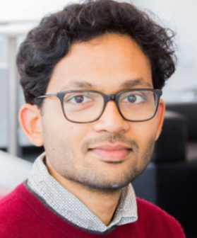
Concept generalization in visual representation learning
M. Bulent
Sariyildiz
Yannis Kalantidis
Diane Larlus
Karteek Alahari
International Conference on Computer Vision (ICCV) 2021
Project page: https://europe.naverlabs.com/cog-benchmark

Slide 2
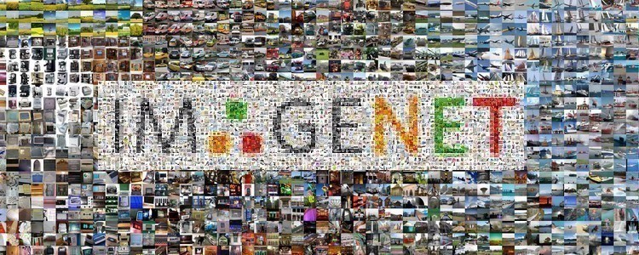
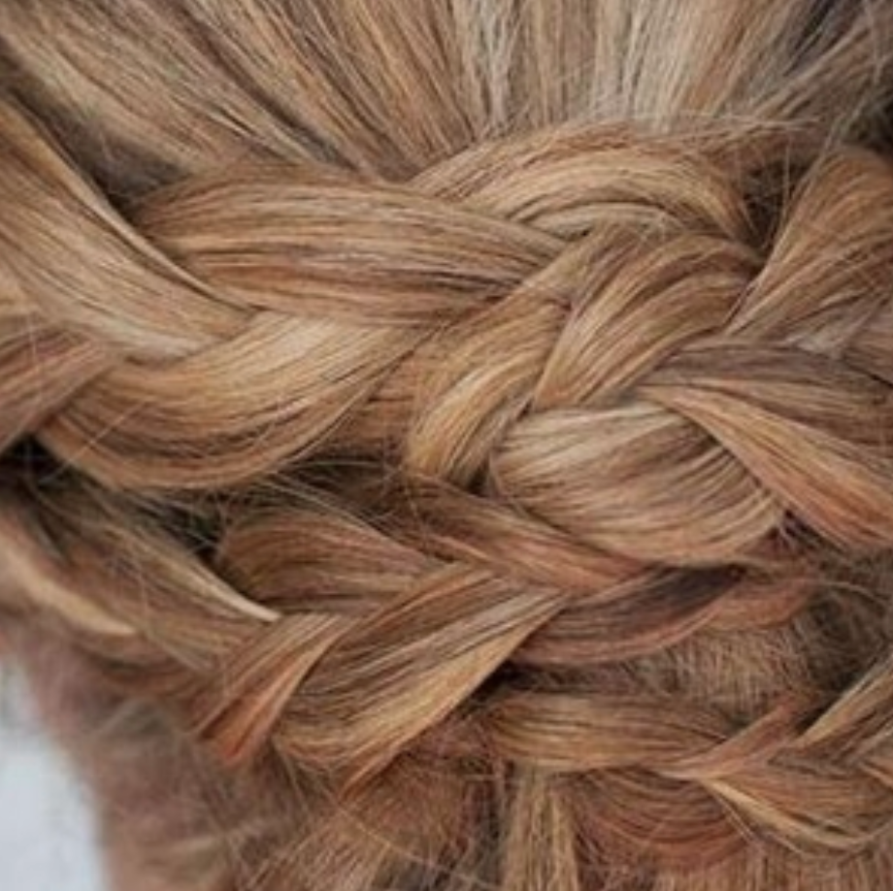
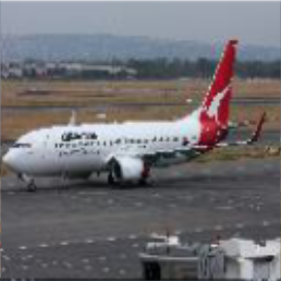
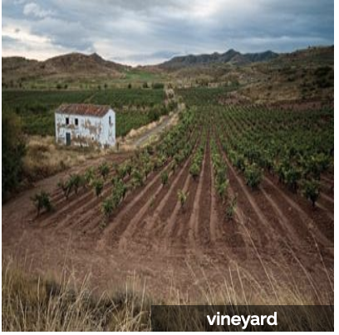
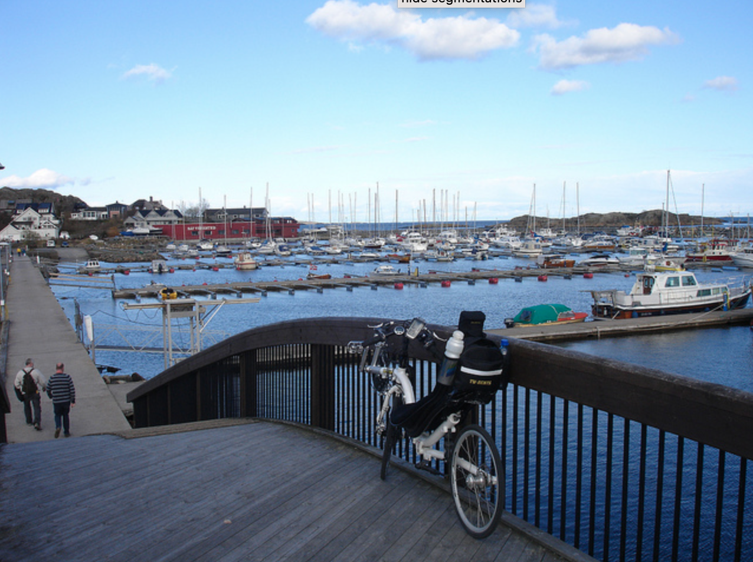
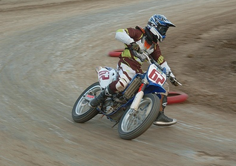
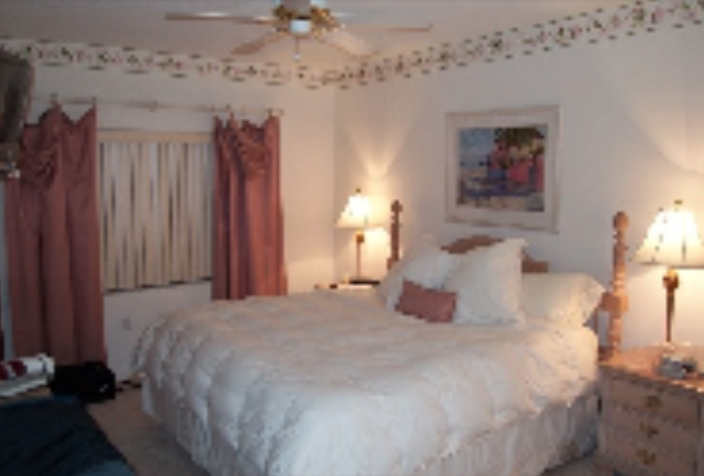
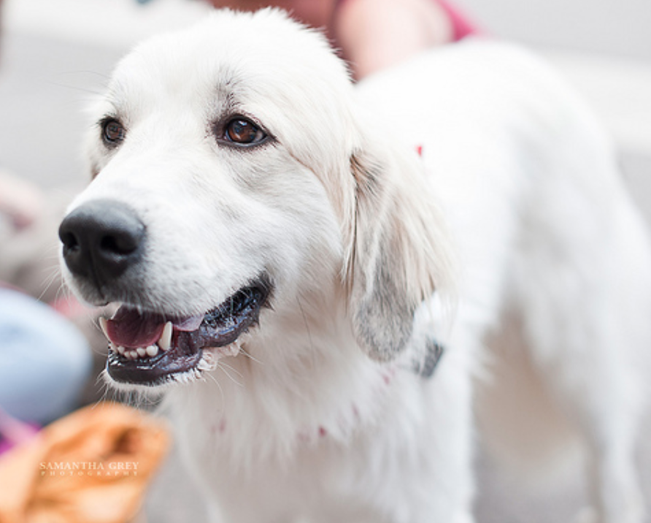
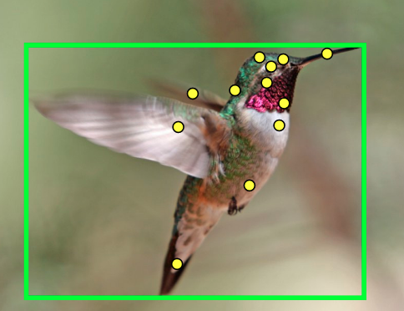
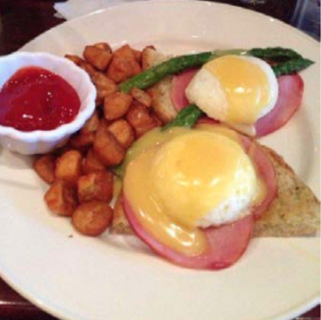
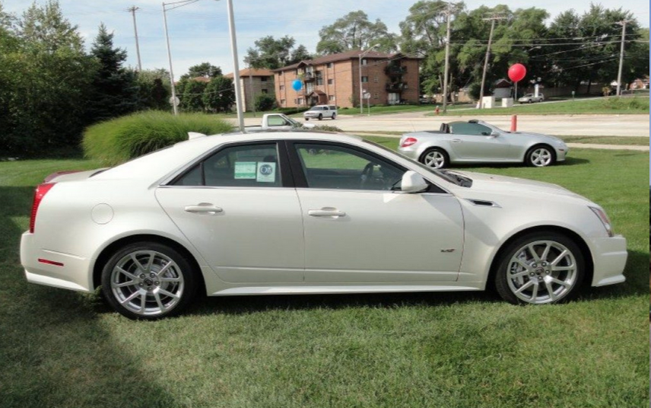
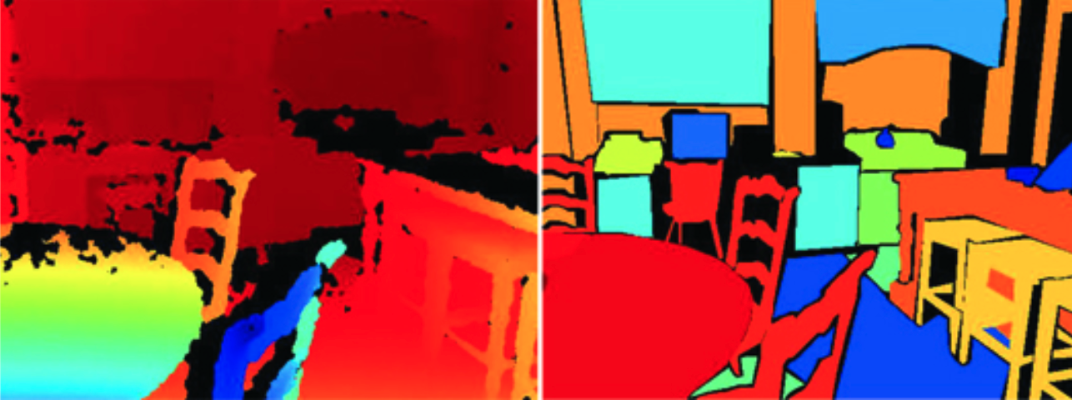
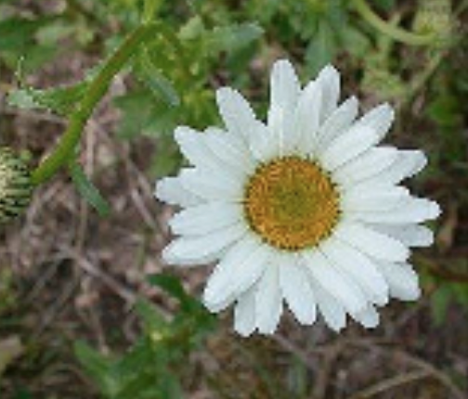
Learning general-purpose visual representations
Model
Train a model on ImageNet-1K ^{[1]}
Transfer the learned representations to downstream datasets ^{[2,3]}
...
DTD
CIFAR10/100
FGVC Aircraft
Places205
MS-COCO
Pascal VOC 2007
SUN397
...
Oxford-IIIT Pets
Birdsnap
Food-101
Stanford Cars
NYU-v2
Oxford 102 Flowers
[1] Russakovsky et al. “ImageNet Large Scale Visual Recognition Challenge”, IJCV 2015
[2] Goyal et al. “Scaling and Benchmarking Self-Supervised Visual Representation Learning”, ICCV 2019
[3] Kornblith et al. “Do Better ImageNet Models Transfer Better?”, CVPR 2019

Slide 3
Concept generalization: Transferring representations across concepts
Model
cats
Train a model on seen concepts
Transfer the learned representations to unseen concepts
dogs
takins
cabbage worms
Sea squirts
Images are from Deng et al. “Imagenet: A large-scale hierarchical image database.” CVPR, 2009

Slide 4
Concept generalization: Transferring representations across concepts
Model
cats
Train a model on seen concepts
Transfer the learned representations to unseen concepts
No systematic approach for evaluating concept generalization due to
unknown semantic similarity between ImageNet-1K and other datasets
dogs
takins
cabbage worms
Sea squirts
Images are from Deng et al. “Imagenet: A large-scale hierarchical image database.” CVPR, 2009

Slide 5
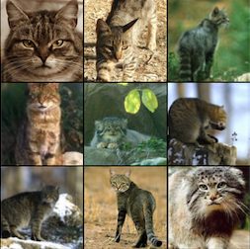
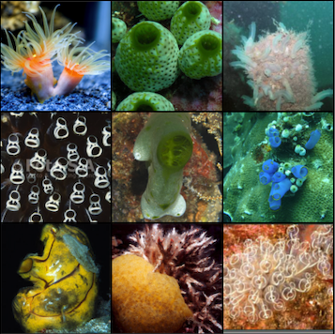
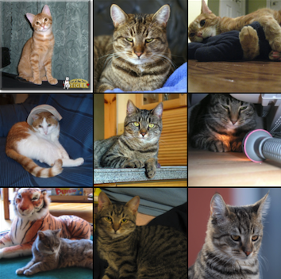
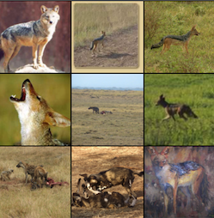
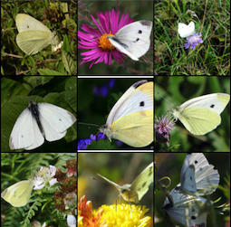
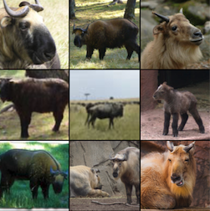
Our ImageNet-CoG Benchmark
A benchmark tailored for concept generalization, built on full ImageNet ^{[2]}
WordNet^{[1]}
Seen and unseen concepts are in the same concept ontology^{[1]} where
semantic similarity between concepts is defined by linguists
[1] Miller. et al. “WordNet: A Lexical Database for English”. ACM-Comm 1995
[2] Deng et al. “Imagenet: A large-scale hierarchical image database.” CVPR, 2009

Slide 6
Creating ImageNet-CoG
1) Measure the semantic distance between concepts using Lin similarity ^{[2]}
WordNet^{[1]}
[1] Miller. et al. “WordNet: A Lexical Database for English”. ACM-Comm 1995
[2] Lin et al. “An information-theoretic definition of similarity.” ICML, 1998
Images are from Deng et al. “Imagenet: A large-scale hierarchical image database.” CVPR, 2009

Slide 7
Creating ImageNet-CoG
1) Measure the semantic distance between concepts using Lin similarity
2) Generalize the semantic distance to sets of concepts, and create levels
ImageNet-1K^{[1]}
Level - 1
Level - 2
Level - 3
Level - 4
Level - 5
ImageNet-1K
[1] Russakovsky et al. “ImageNet Large Scale Visual Recognition Challenge”, IJCV 2015

Slide 8
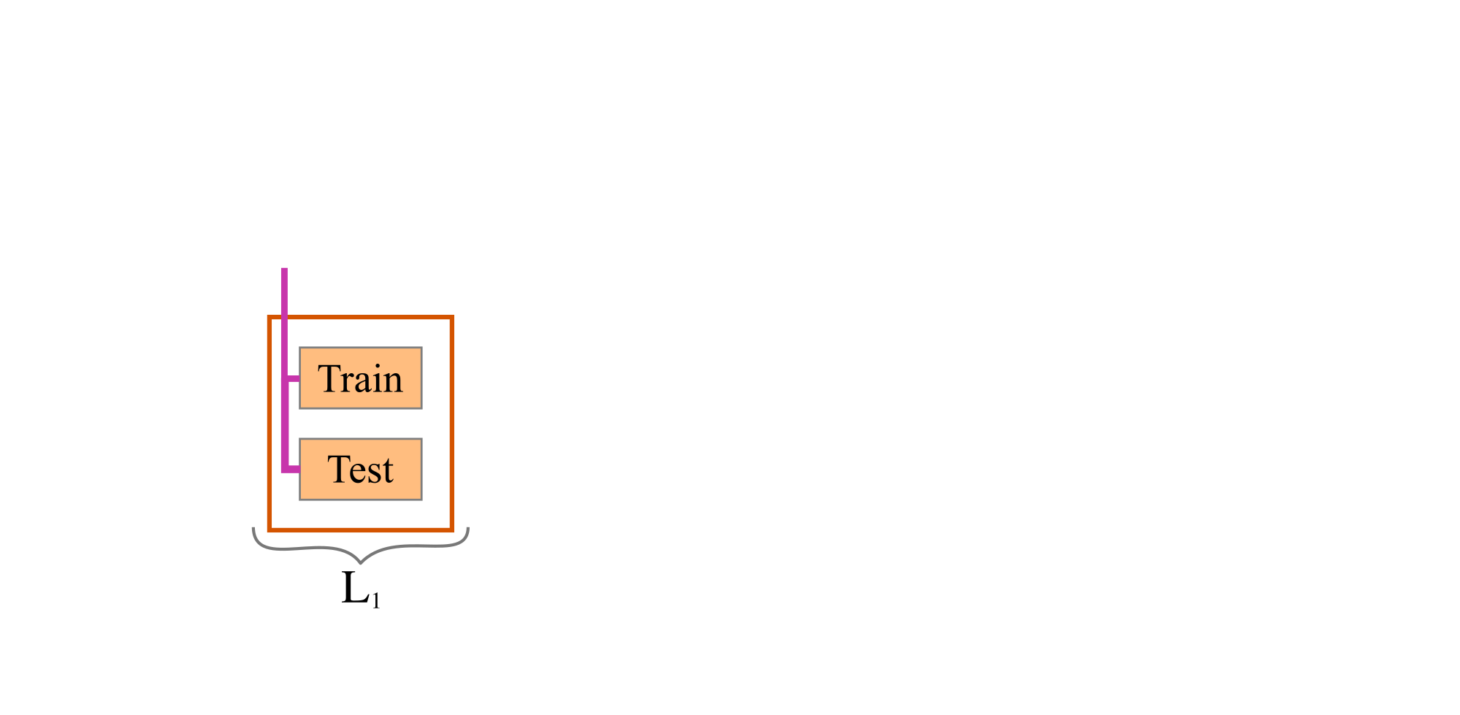
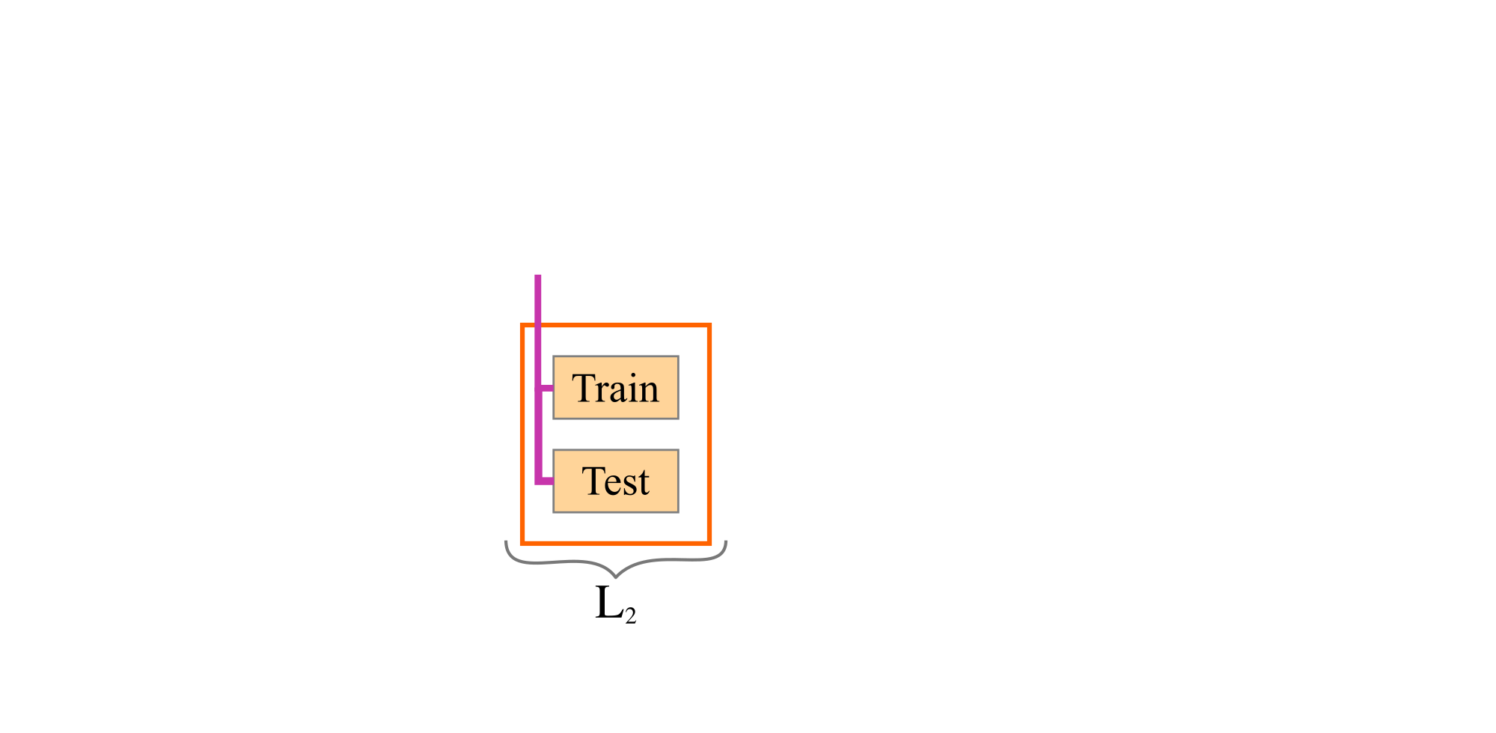
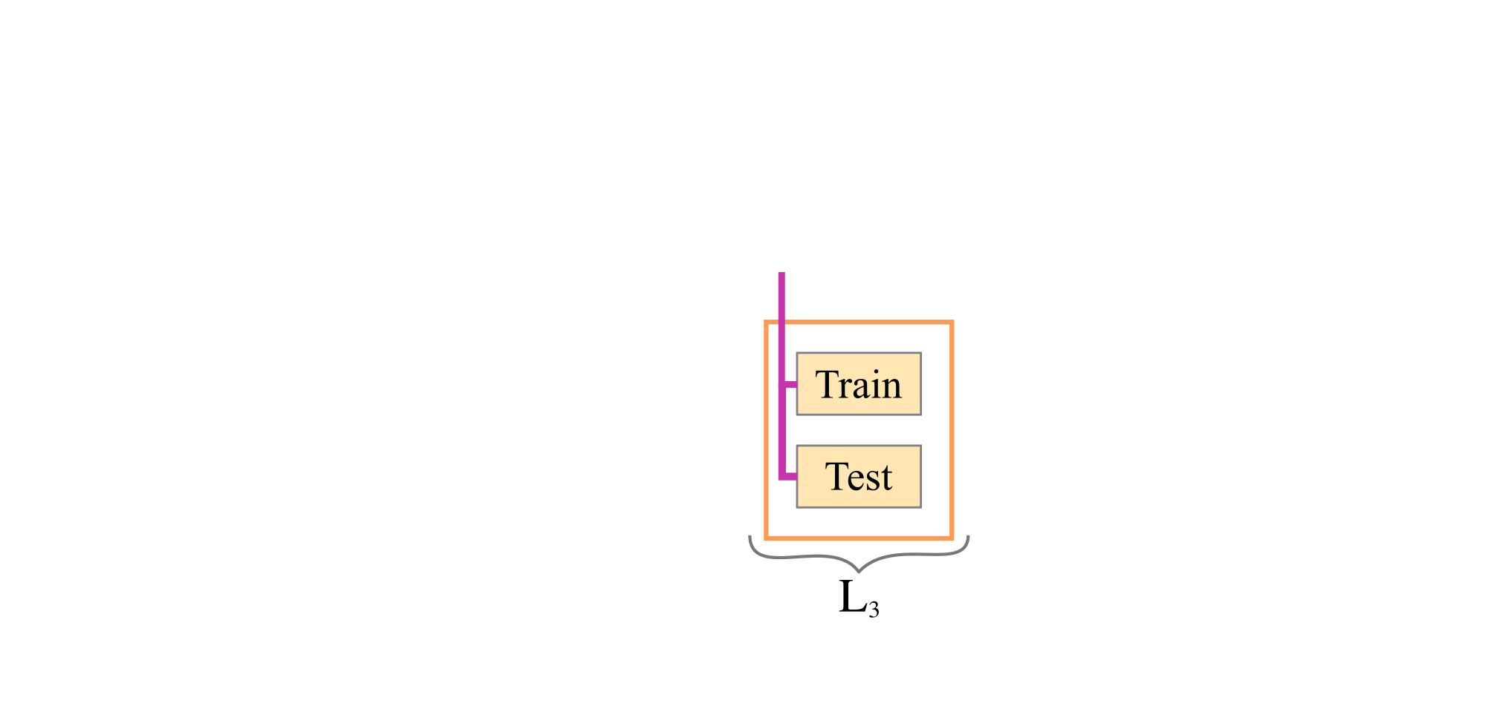
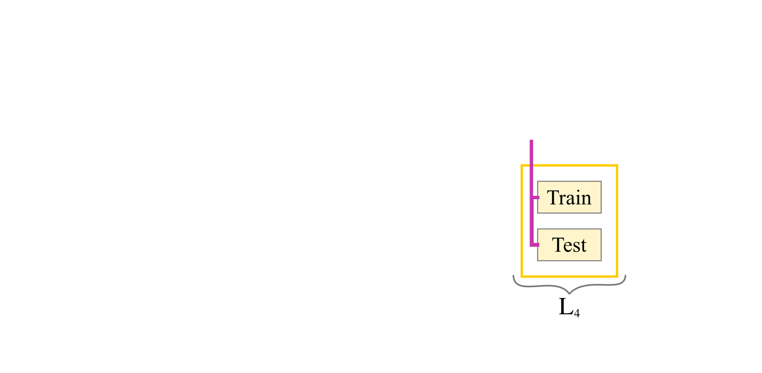
Evaluation protocol for ImageNet-CoG
1) Extract image features for all the concepts
1) Extract image features for all the concepts
2) Train linear classifiers on each level separately

Slide 9
Evaluations with 31 representation learning methods
Baseline: Supervised ResNet50 in torchvision
Architecture:
10 CNN, Transformer or NAS models
Compare against
4 groups of methods
Self-supervision: 10 self-supervised models
Regularization:
6 models trained with regularization techniques
Data:
4 models pre-trained with additional data

Slide 10
A subset of our experiments (come to our poster for more!)
Baseline: Supervised ResNet50 in torchvision
1) Performance of all 31 models monotonically decreases from ImageNet-1K to Level-5
2) Self-supervised models generalize well
3) Label-based regularization models might be overfitting
Baseline vs.
Self-supervised models
Baseline vs.
Regularization techniques

Slide 11
Conclusion
We proposed the ImageNet-CoG benchmark
Enables measuring concept generalization in a controlled way
Seen concepts ⇒ ImageNet-1K concepts
Unseen concepts ⇒ Sampled from the full ImageNet-21K dataset
5 Levels ⇒ Increasingly challenging transfer datasets
Try your own method
Can be used out-of-the-box for ImageNet-1K pretrained models
31 models already evaluated on ImageNet-CoG
Interesting insights on popular state-of-the-art methods
Please come to our poster to discuss Session-8 → Oct. 13 Wednesday 9:00-10:00 AM EDT Oct. 15 Friday 4:00-6:00 PM EDT
Project page: https://europe.naverlabs.com/cog-benchmark

